Slide 1
Topics
Catching Exceptions
try { .. } catch () { .. }

Slide 2
Exception Handling
Exception Handling Requires Four Steps
Finding the Problem→ Identify the Statements Which May Result in Exception. Put all those statements in a try {..} block.
Inform that an Exception is thrown (Throw the Exception) << Note Down the difference between throw vs throws clauses>>
Catch the Exception Using catch( .. ) statements
Provide the Exception Handling Code in catch( .. ) { .. } blocks

Slide 3
Exception Handling Syntax
try
{
<statements that can throw exceptions>
}
catch(Exception-Type-1 e1) {….}
catch(Exception-Type-2 e2) {….}
catch(Exception-Type-3 e3) {….}
………………………………..
catch(Exception-Type-N e4) {….}
Important Points :
try { .. } block may have one or multiple statements.
try { .. } block may be capable of either throwing either a single type or multiple types of exceptions.
3. There can be multiple catch() { .. } blocks associated with single try { .. } block.
4. If try{} block can throw multiple exceptions then user should catch all exceptions. (one catch block for each type of exception)

Slide 4
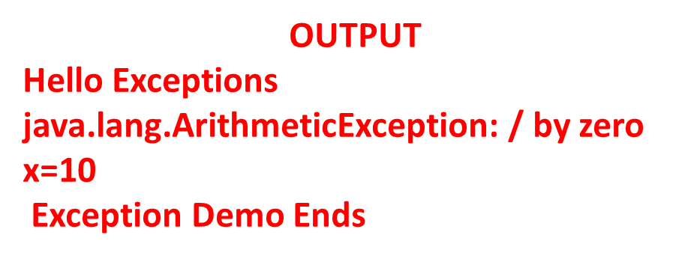
Catching an Exception : Example 1
class ExceptionDemoTest
{
public static void main(String args[])
{
System.out.println(" Hello Exceptions");
int d = 0;
int x = 10;
try
{
x = 42 / d;
}
catch(ArithmeticException e) { System.out.println(e); }
System.out.println("x=" +x);
System.out.println(" Exception Demo Ends");
}// End of Method
}// End of class

Slide 5
Catching Multiple Exceptions
Example
class ExceptionDemoTest
{
public static void main(String args[])
{
int a[]= {5,10};
try
{
int b= Integer.parseInt(args[0]);
int x = a[b]/(b-a[1]);
System.out.println("x="+x);
}
catch(ArithmeticException e) { System.out.println(e); }
catch(NumberFormatException e) { System.out.println(e); }
catch(ArrayIndexOutOfBoundsException e) { System.out.println(e);}
System.out.println("Exception Demo Ends");
}// End of Method
}// End of class

Slide 6
Catching Multiple Exceptions
Example …
java ExceptionDemoTest
java.lang.ArrayIndexOutOfBoundsException: 0
Exception Demo Ends
java ExceptionDemoTest 0
x=0
Exception Demo Ends
java ExceptionDemoTest 1
x=-1
Exception Demo Ends
java ExceptionDemoTest a
java.lang.NumberFormatException: For input string: "a"
Exception Demo Ends

Slide 7
Nested Try Statements
Try{ } statements can be nested. One try block may contain another try block
In case of nested try blocks, context of that exception is pushed onto stack.
Inner try block may/or may not have catch statements associated with it.
If an exception is thrown from inner try block then first inner catch statements are matched (if present) . If no match is found then outer try block are matched. If there also no match found then default handler will be invoked.
However, if outer try block throws the exception then only outer try blocks are matched.

Slide 8
Nested try statements :
A Typical Syntax
try
{
Statement- A;
Statement-B;
try
{
Statement-C;
Statement-D;
}
catch(CException e) { …. }
catch(DException e) { …. }
}
catch(AException e) { …. }
catch(BException e) { …. }
try
{
Statement-A;
Statement-B;
try
{
Statement-C;
Statement-D;
}
}
catch(AException e) { …. }
catch(BException e) { …. }
catch(CException e) { …. } catch(DException e) { …. }

Slide 9
Nested try statements :
A Typical Syntax …
try
{
Statement-A;
Statement-B;
try
{
Statement-C;
Statement-D;
}
catch(CException e) { …. }
catch(DException e) { …. }
}
catch(AException e) { …. }
catch(BException e) { …. }
catch(CException e) { …. }
catch(DException e) { …. }

Slide 10
Nested try { .. } : Example
class nestedtry
{
public static void main(String args[])
{
int a[] = { 2,5,6}; // { a[0] = 2, a[1] = 5, a[2] = 6}
try // outer try
{
int b = Integer.parseInt(args[0]);
try // inner try
{
int c[] = { 4,5,6}; // { c[0] = 4, c[1] = 5, c[2] = 6}
int d = c[b]/(c[b]-4);
} // End of inner try
// catch Blocks Associated With Inner Try Block
catch(ArrayIndexOutOfBoundsException e)
{
System.out.println("Exception : "+ e.toString());
System.out.println("By Inner try");
}

Slide 11
Nested try { .. } : Example …
catch(ArithmeticException e)
{
System.out.println("Exception : "+ e.toString());
System.out.println("By Inner try");
}
} // End of outer try
// Catch Blocks Asscoiated With Outer try Block
catch(ArrayIndexOutOfBoundsException e)
{
System.out.println("Exception : "+ e.toString());
System.out.println("By Outr try");
}
catch(NumberFormatException e)
{
System.out.println("Exception : "+ e.toString());
System.out.println("By Outer try");
}
} // End of main
} // End of class

Slide 12
Nested try { .. } : Example …
java nestedtry
Exception : java.lang.ArrayIndexOutOfBoundsException: 0
By Outer try
java nestedtry 4
Exception : java.lang.ArrayIndexOutOfBoundsException: 4
By Inner try
java nestedtry 0
Exception : java.lang.ArithmeticException: / by zero
By Inner try

Slide 13
Thank You

